Slide 1

t
HEXBUGS 2.0: ASSEMBLING AND COMPONENTS SESSION

Slide 2
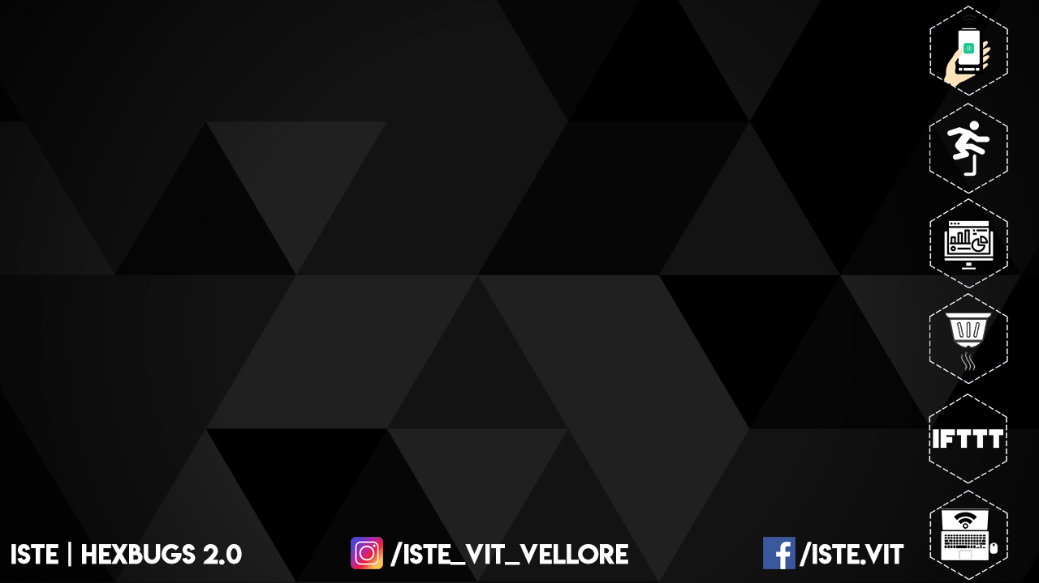
EQUIPMENT’S REQUIRED:
Class A leg - 6
Class B leg - 6
Bot metal body -1
Wheels - 2
Motor - 2
Arduino - 1
Node MCU - 1
Motor Driver - 1

Slide 3

ASSEMBLING:

Slide 4
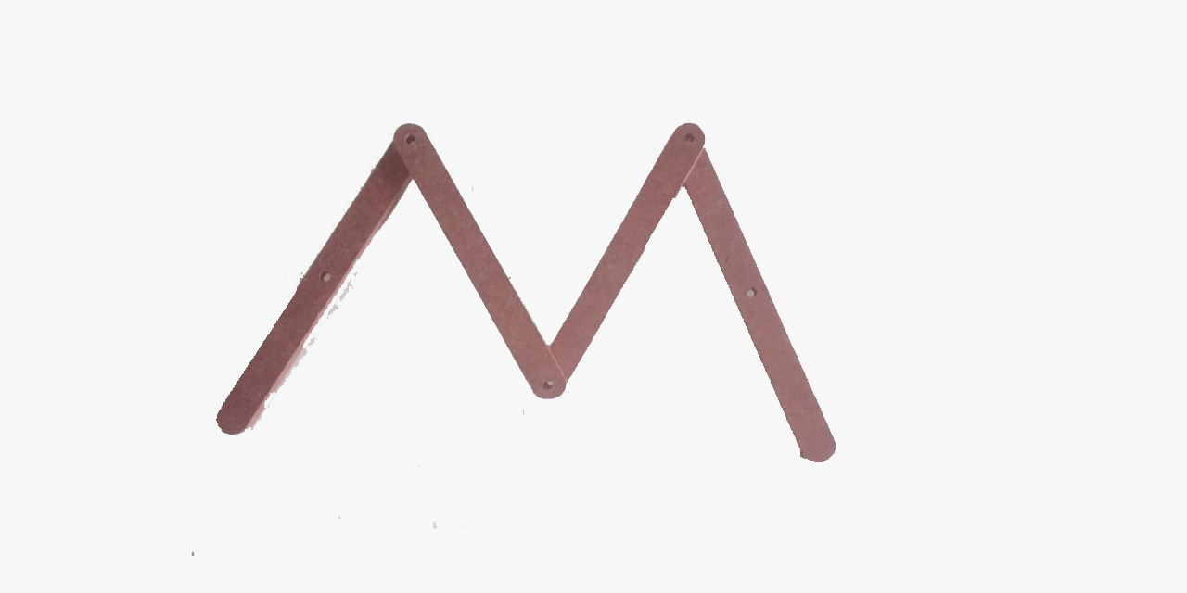

Slide 5
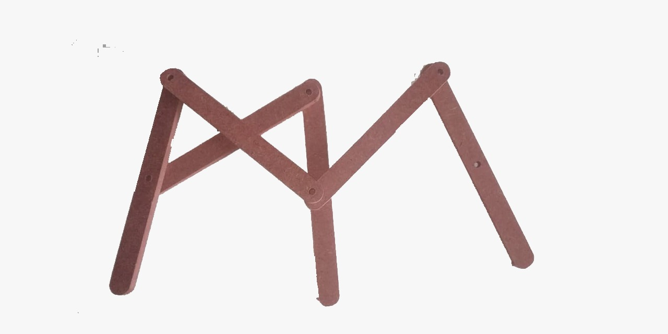

Slide 6
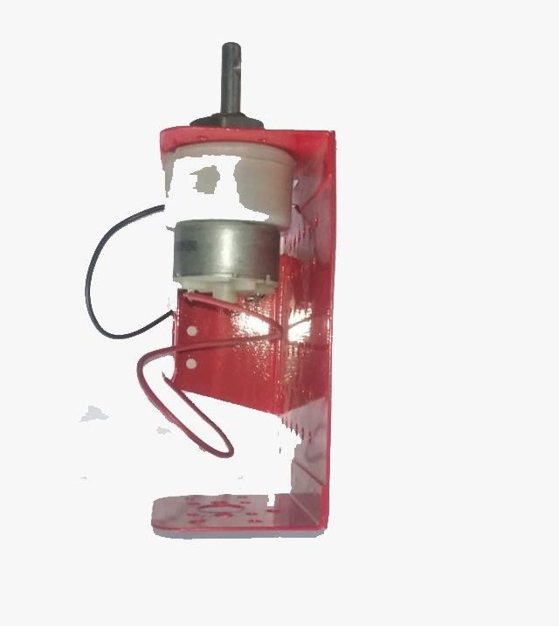
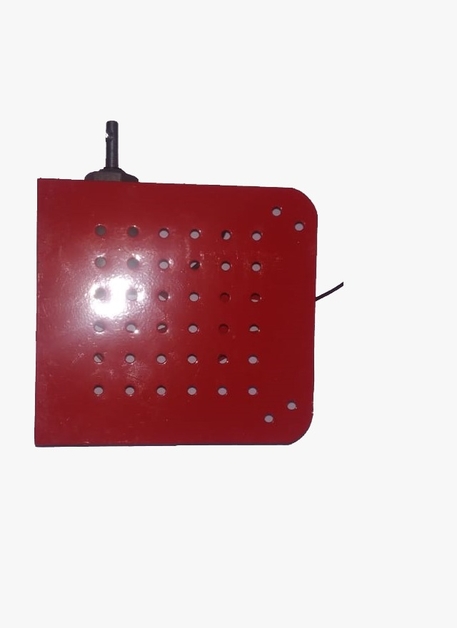

Slide 7
